Slide 1

Comparing Influenza Trends in New York State with an Interactive Dashboard
Katherine Huerta
Deliverable 2
Data 606 SP 2020
https://www.nfid.org/infectious-diseases/influenza-flu/

Slide 2
Related Work
Related Literature
C. Cheng et al., Journal of Medical Internet Research (2011)
Outcome: Developed and employed an influenza surveillance dashboard (cases in Hong-Kong) that models efficient dissemination of surveillance data.
Key Takeaway: Proper dissemination of surveillance data increases the impact the dashboard has on the user.
Health officials and policy makers
C. Cheng, D. Ip, B. Cowling, L. Ho, and E. Lau, “Digital dashboard design using multiple data streams for surveillance with influenza surveillance as an example”, J Med Internet Res. 2011 Oct-Dec; 13(4): e85. Published online 2011 Oct 14, doi: 10.2196/jmir.1658. Available: https://www.ncbi.nlm.nih.gov/pmc/articles/PMC3222192/. [Accessed Feb. 19, 2020].

Slide 3
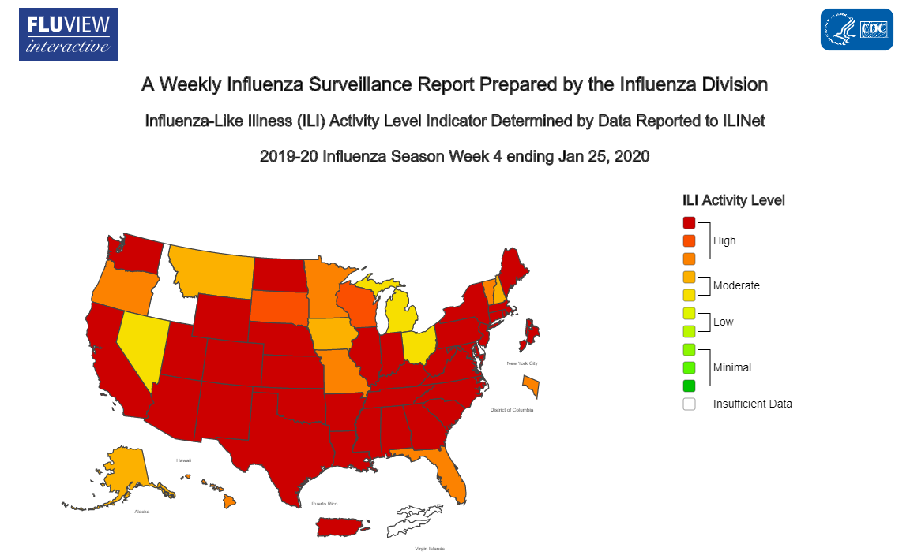
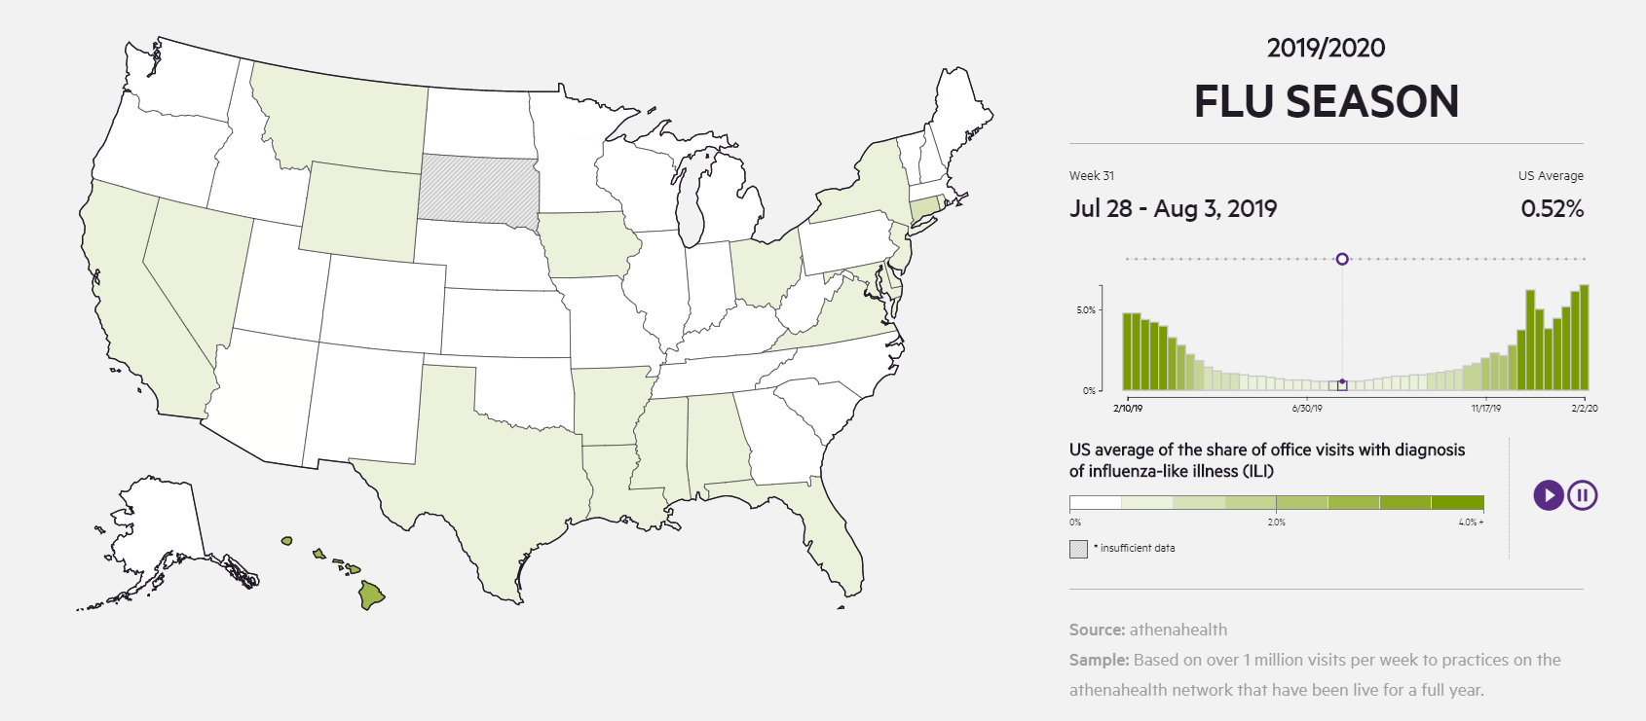
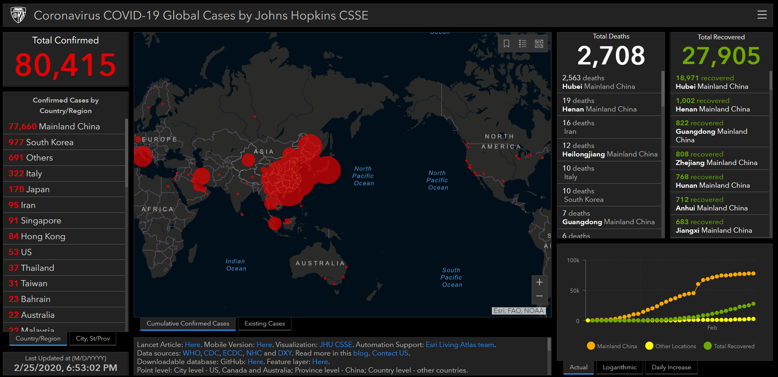
Related Work
Similar Projects (Dashboards)
New York State Flu Tracker (NYS Health Connector, 2020)
FluView Interactive (CDC, 2020)
AthenaInsight Flu Dashboard (L. VanWhy, and P. Galebach, 2019)
“Mapping 2019-nCoV” (L. Gardner, 2020)
https://gis.cdc.gov/grasp/fluview/main.html
https://www.athenahealth.com/insight/flu-dashboard-2017-2018
https://www.arcgis.com/apps/opsdashboard/index.html#/bda7594740fd40299423467b48e9ecf6

Slide 4
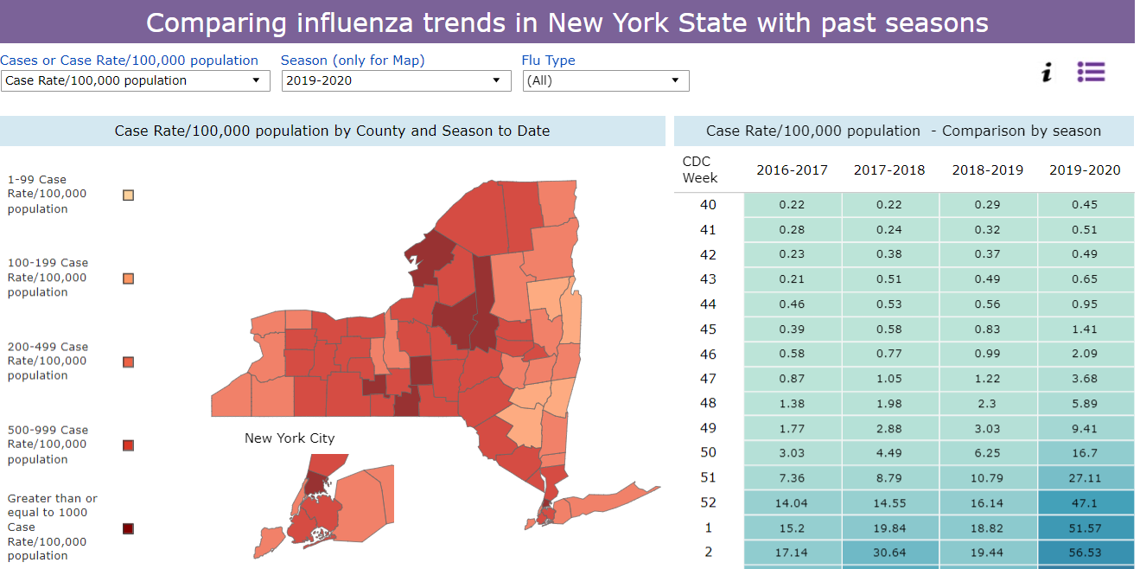
https://nyshc.health.ny.gov/web/nyapd/new-york-state-flu-tracker
Figure 1. Section of New York State Flu Tracker that displays the case rate per 100,000 population in the form of a density map. The panel to the right compares the case rate for each week between the four most recent flu seasons.

Slide 5
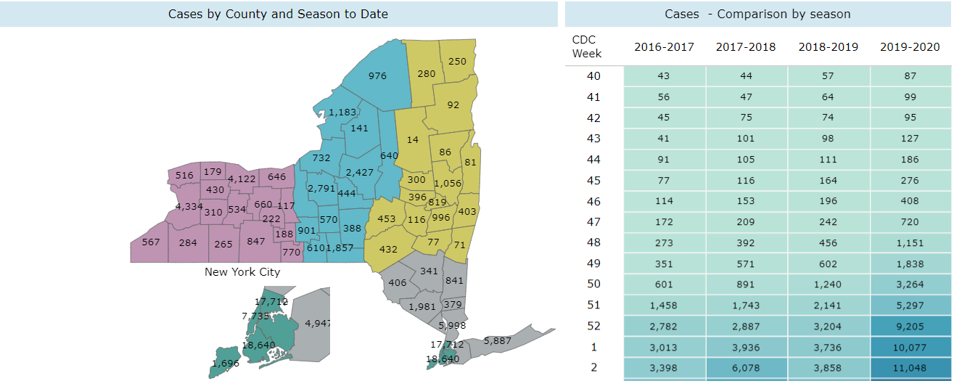
https://nyshc.health.ny.gov/web/nyapd/new-york-state-flu-tracker
Figure 2. Section of NYS Flu Tracker that displays the number of cases by county and season to date. The panel to the right displays a comparison of the number of cases for each week between the four most recent flu seasons.

Slide 6
Related Work
Similar Projects (Dashboards)
New York State Flu Tracker (NYS Health Connector, 2020)
Project Differences
Will visualize/compare all recorded seasons (not just from 2016 – 2020)
Using open source software and code (Python, Jupyter Notebook)
Providing the methodology for:
Others to replicate – addresses validity
Others to improve upon – addresses extensibility
Transparency for a deeper understanding by users

Slide 7
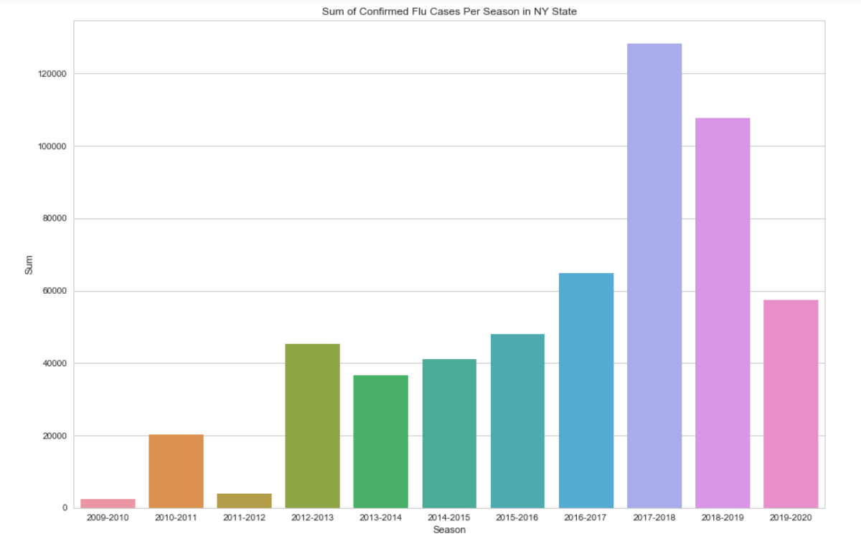

Exploratory Data Analysis – Key Observations
Sum of confirmed flu cases appears to be highest in 2017-2018 season so far.
2017-2018: 128,247 cases
Figure 3. Bar plot displaying the sum of confirmed flu cases (influenza A, B, and unspecified) for each flu season in New York State. The x-axis represents the sum (ranging from 0 – 140,000 cases, increments of 20,000 cases) the y axis represents the season (2009 → present). The 2019 – 2020 flu season is not over until May, so the number of confirmed flu cases will change each week.
2018-2019: 107,805 cases
WHY?
Difference = 63,482 cases
2016-2017: 64,765 cases

Slide 8
Questions and Feedback?
uv94014@umbc.edu
https://github.com/kathuerta/DATA606
Thank you!
https://www.nfid.org/infectious-diseases/influenza-flu/

